Slide 1
Exosphere
Atilla Borga Iskender
Tim Meijvogel
Notes:
Name of the game

Slide 2
Elevator pitch
2D hardcore platformer game where the player kills to progress and loot.
Notes:
One line elevator pitch sentence

Slide 3
Aesthetics overview
Story
Setting
Game World
Characters
Genre
Flow
Mood
Magic Circle
Notes:
Aesthetics overview: Setting,Genre, Mood, Magic circle, story, characters, game world etc.)

Slide 4
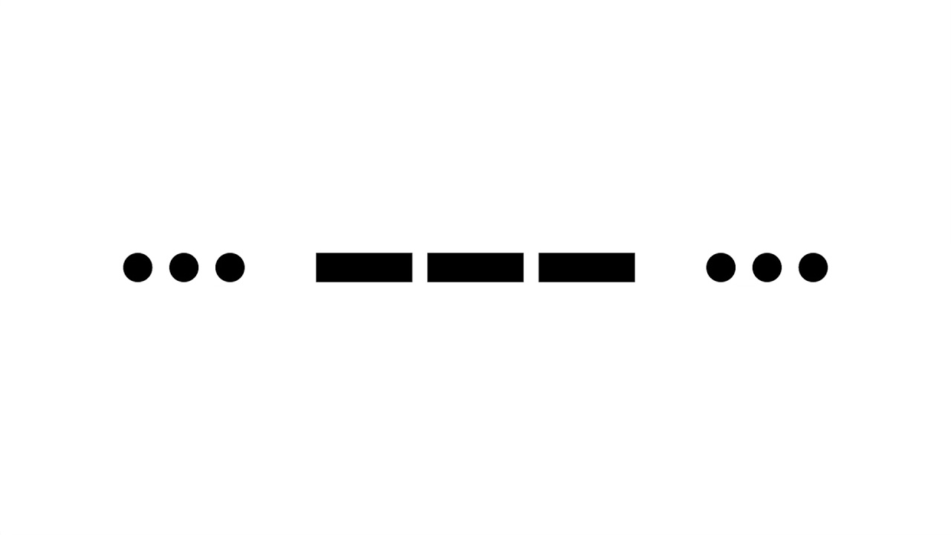

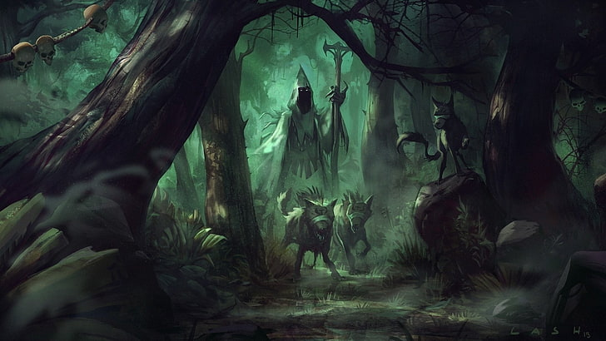

Story
S.O.S. Signal
Finding the source
getting stuck on a planet
dangers lie ahead

Slide 5
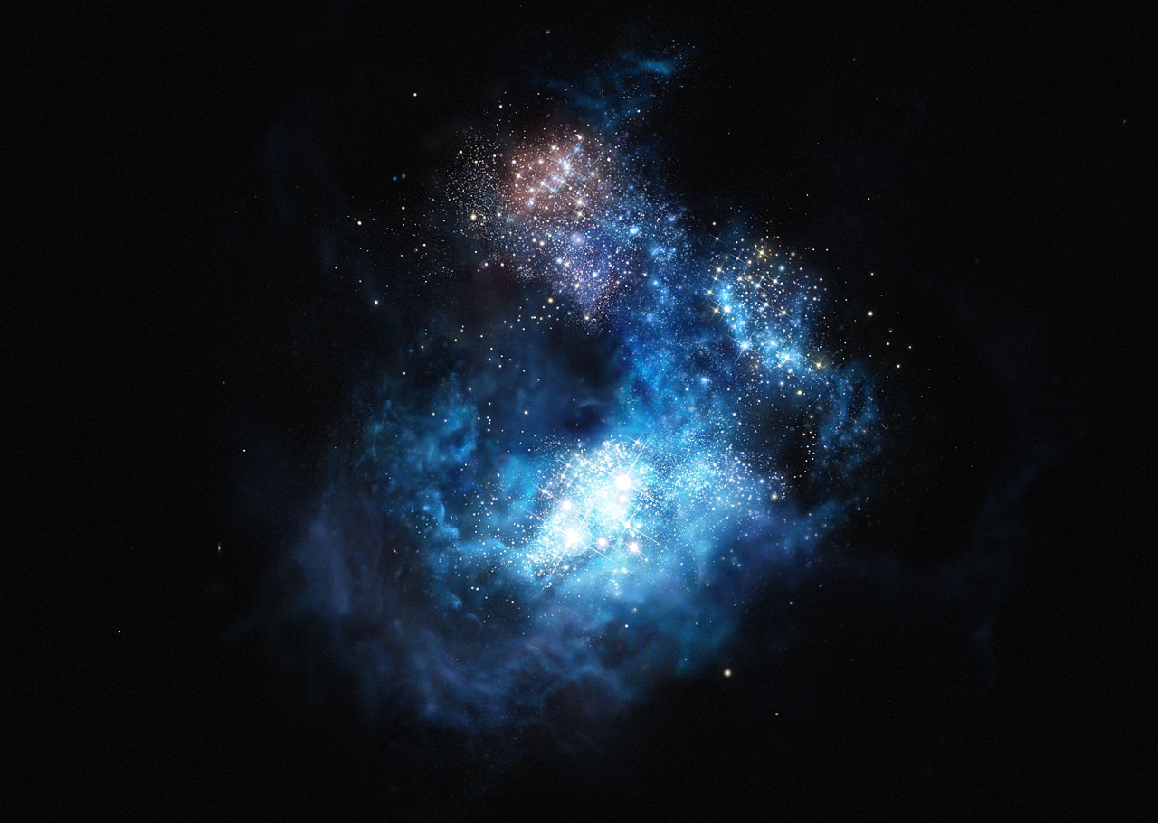
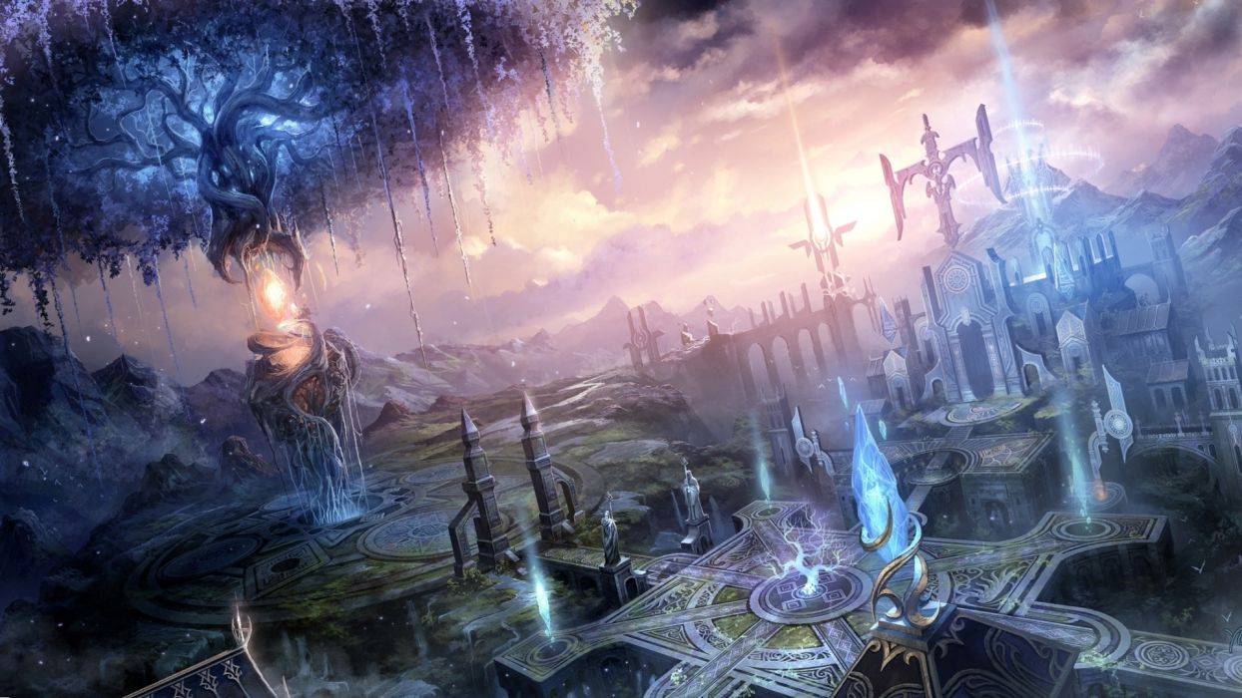
Setting
Medieval/Magical
Cosmos Redshift 7

Slide 6
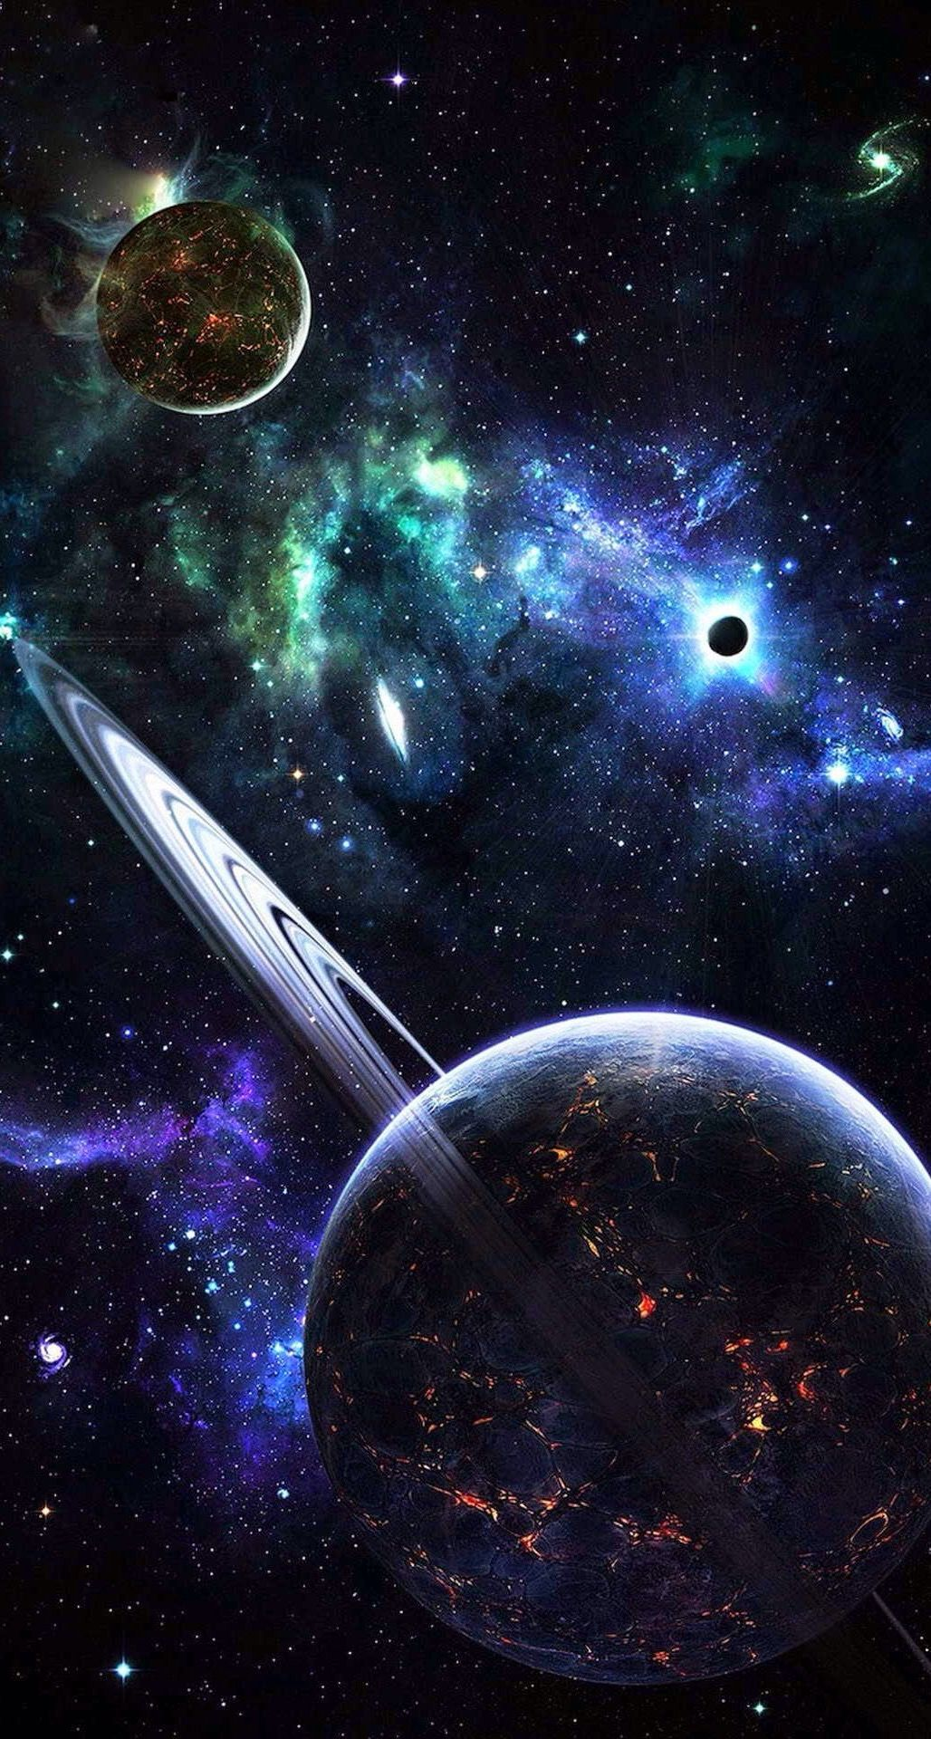
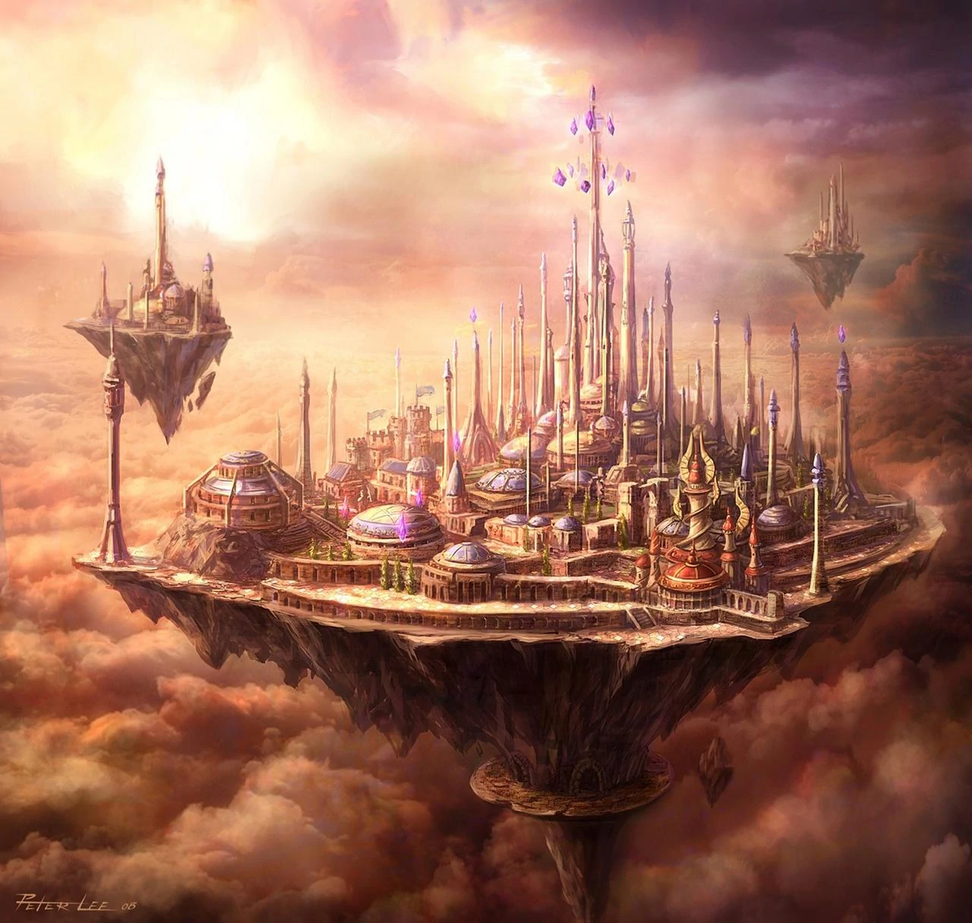
Game World
Magic cities
Unknown planet

Slide 7

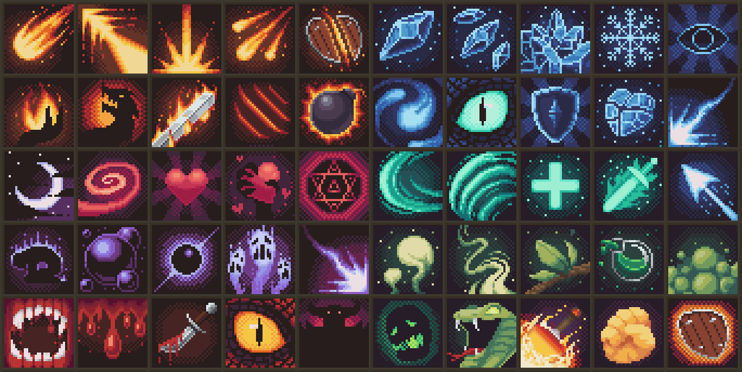
Characters
Multiple classes
Different skills

Slide 8
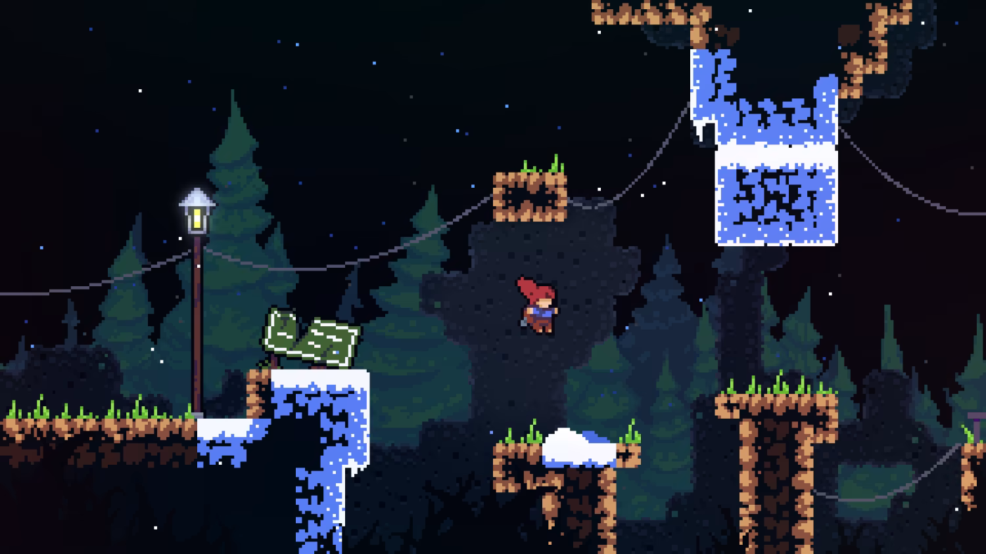
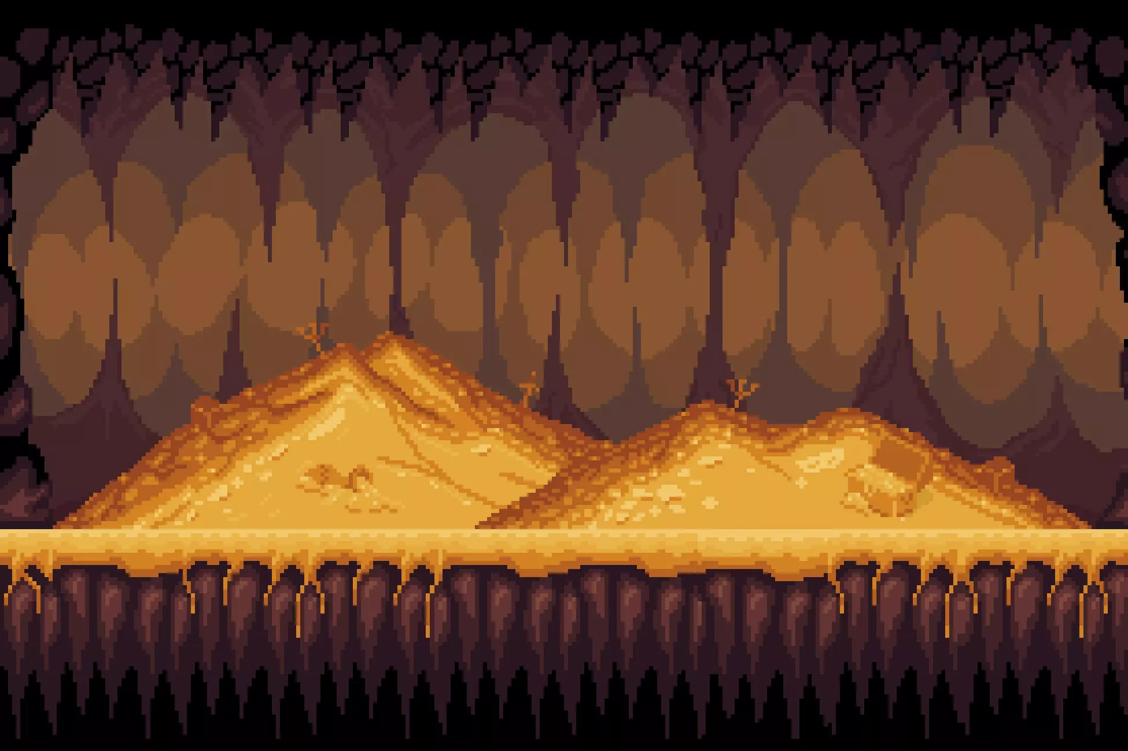
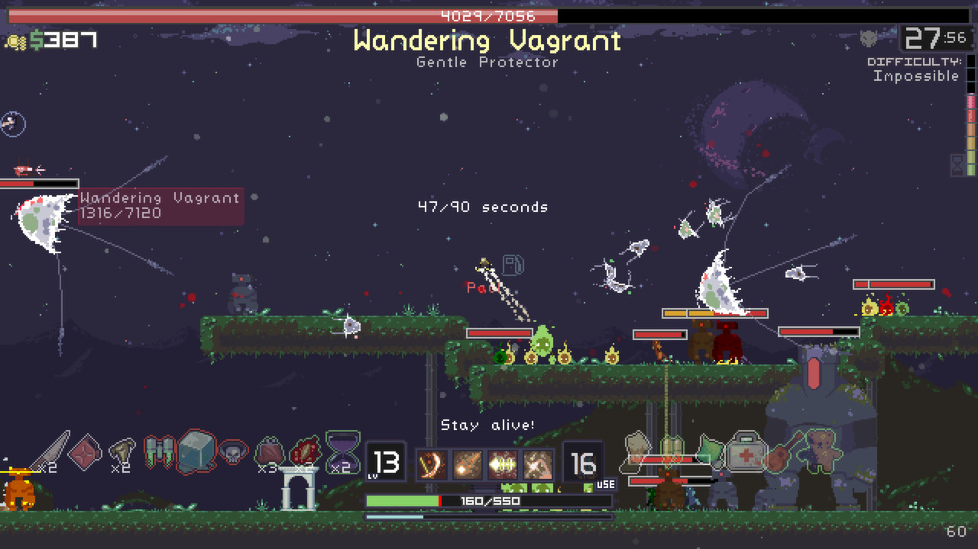
Genre
2D
Platformer
Shooter
Hardcore
Roguelike

Slide 9
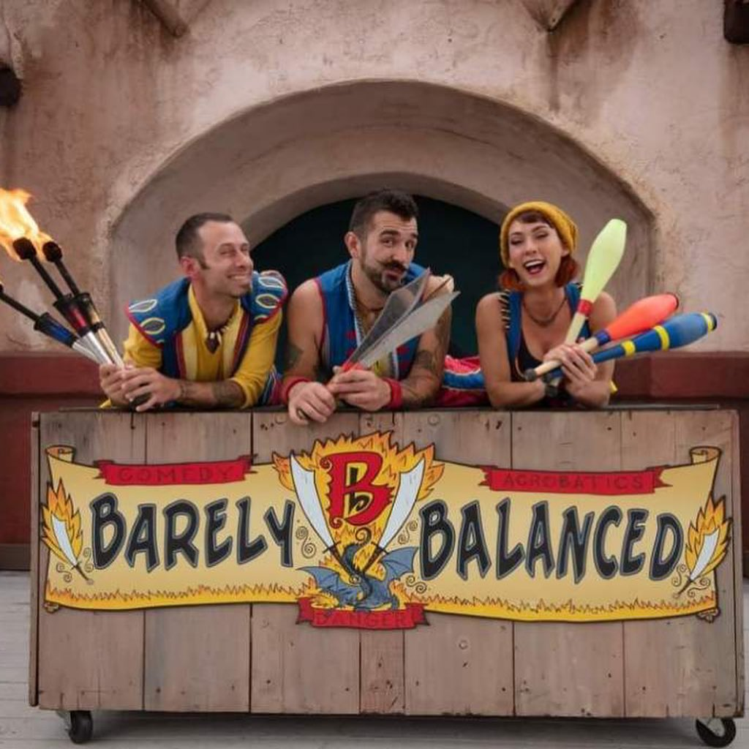
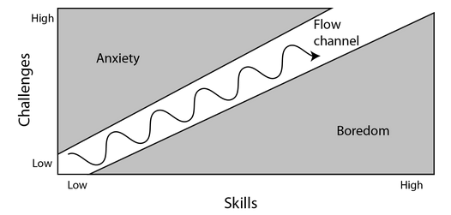
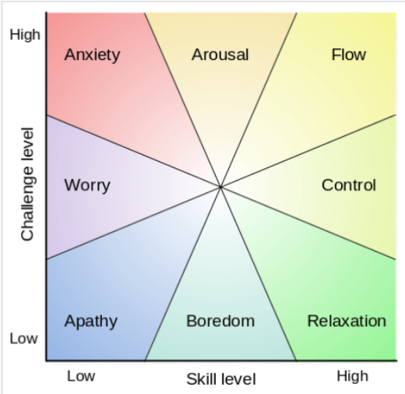
Flow
Balancing
Difficulty
Notes:
Insights in how you approach the concept of flow and balancing in your game, supported with level designs

Slide 10
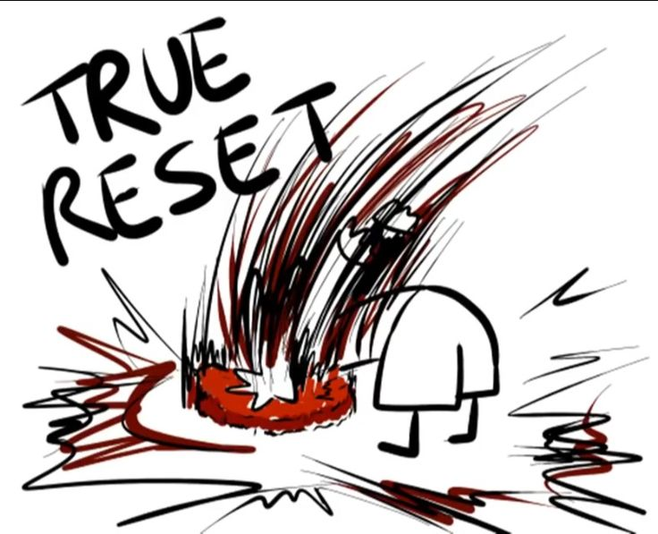

Mood
How will the player feel?

Slide 11


Magic Circle
Rules of our world
What will the player do
How do we make the players feel immersed

Slide 12
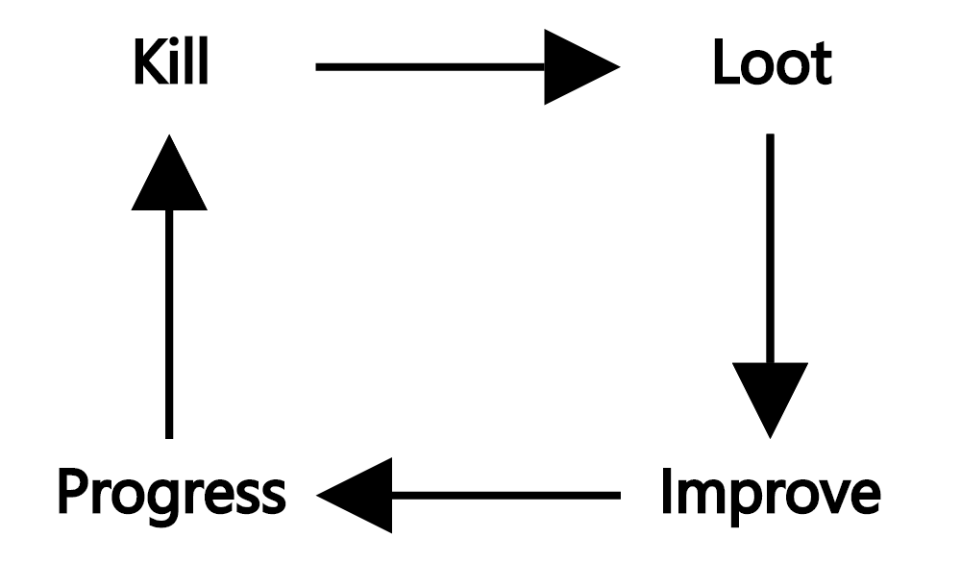
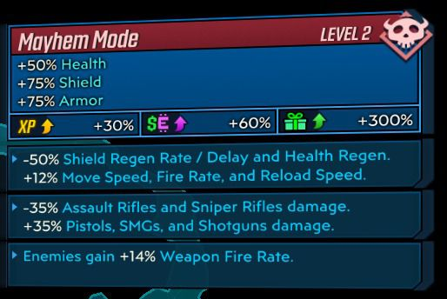
MDA
Core Loop
Types of fun
Artifacts
Notes:
Insights in MDA (including Core Loop)

Slide 13
Prototype
https://youtu.be/4E0l6Y4kVWs
https://xd.adobe.com/view/58b63360-727b-459a-9867-71a0e2650556-0de5/
Notes:
Prototype (low fidelity) video highlighting core game play

